Slide 1


Health revolution Hack 2025
Sales Analysis and Forecasting
Team name : Insight Innovators
Team No
RMKCET

Slide 2
Health revolution
Hack 2025
Team members name | Mail id | Team faculty mentors | Faculty mentor mail ID | Cognizant mentor name | Cognizant mentor mail ID
MSV Chitesh | munacs088@rmkcet.ac.in | Dr. Sankar Ganesh S | hod_cse@rmkcet.ac.in | Mr. Sagar Pawan Cherukuri | Sagarpavan.cherukuri@ cognizant.com
Arun SK | aruncs009@rmkcet.ac.in
Dinesh Kumar G | dinecs027@rmkcet.ac.in
Sathish S | sathcs172@rmkcet.ac.in
Sidharth A | sidhcs130@rmkcet.ac.in |  |  | Mr. Saravanan S | saravanan.selvavinayaga m@cognizant.com
Rupesh V | vrupcs145@rmkcet.ac.in
Vishal Y | vishcs152@rmkcet.ac.in
Rahul Rajkumar | rahucs181@rmkcet.ac.in
Team details
Team Name – Insight Innovators
Team No – 16
RMKCET
2

Slide 3
Health revolution Hack 2025
Mentor connect details (Kindly add the details of the connect had with the mentors)
Date of connect | Time | Platform | Agenda of the meet
25-08-2025 | 11:00 | GoogleMeet | Report on tasks completed and review.
26-08-2025 | 11:00 | Conference Call | Doubt Clarification.
27-08-2025 | 11:15 | GoogleMeet | Review and Insights.

Slide 4
Health revolution Hack 2025
Problem statement detailing
Predicting future sales in the pharmaceutical sector is challenging due to fluctuating demand,
seasonal variations, and changing market trends.
Companies often lack accurate forecasting methods, which affects decision-making in sales,
marketing, and inventory management.
Poor sales predictions can lead to overstocking or stockouts, resulting in financial losses and
customer dissatisfaction.
There is a strong need for advanced time series forecasting techniques that can capture trends,
seasonality, and data variance more effectively.
Inconsistent forecasting reduces supply chain efficiency, leading to resource wastage and
missed opportunities.
Validating and comparing different forecasting models is essential to ensure reliability across datasets with diverse characteristics.

Slide 5
Health revolution Hack 2025
Solution
The solution converts raw pharmaceutical sales data into actionable insights using advanced analytics.
Provides an interactive Sales Overview Dashboard to review past drug-wise sales performance in detail
Offers a Sales Analytics Dashboard powered by forecasting models to predict future sales, demand,
and trends. Built on a modern technology stack (React.js for frontend, Flask API for backend, PostgreSQL
for database) ensuring scalability and efficiency.
Enables managers to optimize inventory, anticipate demand, and improve revenue planning through
data-driven decision making.

Slide 6

Health revolution Hack 2025
Source code
Source code stored on GitHub
https://github.com/Rahul102004/Sales-Analysis-Forecasting
DataSets
DataSets Collected from Kaggle
https://www.kaggle.com/code/milanzdravkovic/ pharma-sales-data-analysis-and-forecasting/output
6

Slide 7
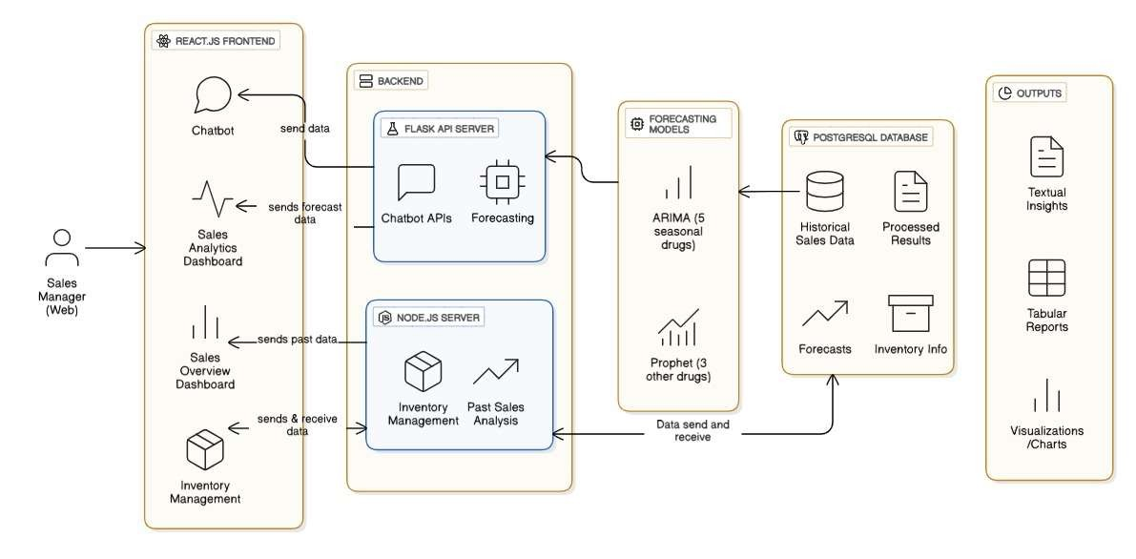
Health revolution Hack 2025
Architecture diagram
7

Slide 8
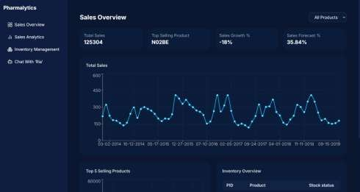
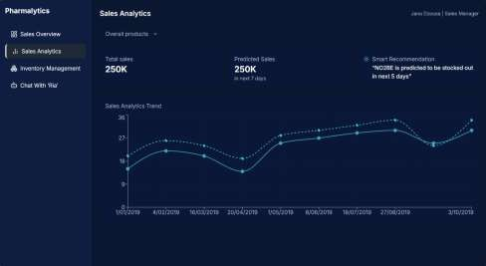
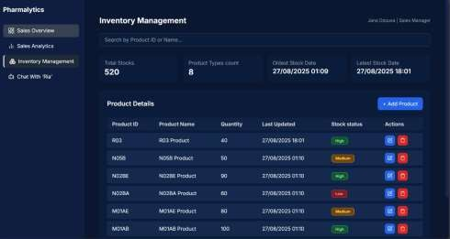
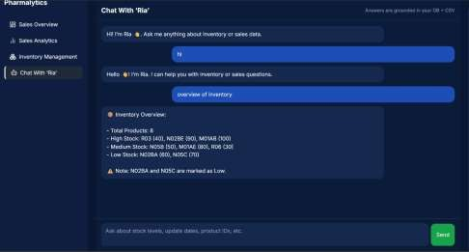
Health revolution Hack 2025
User Interface
© 2023 Cognizant

Slide 9
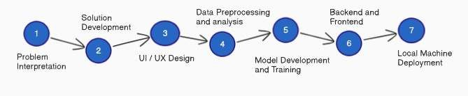
Health revolution Hack 2025
Roadmap
Data Preprocessing
Loaded the dataset and checked for missing values — no missing values were found. Detected outliers and removed them using the capping method. Checked for Stationarity one non-stationary column was made stationary using the differencing method. Preprocessed dataset finalized and downloaded for further analysis

Slide 10
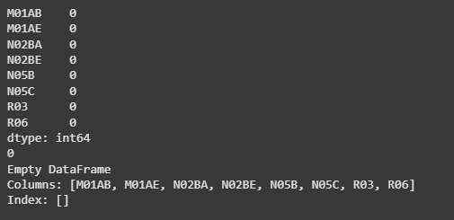
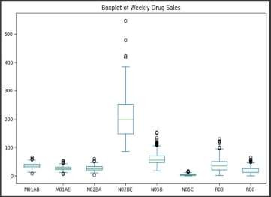
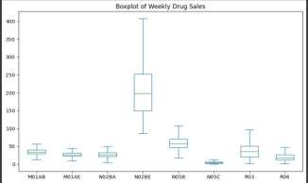
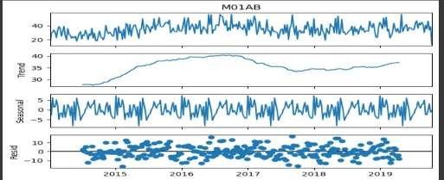
Health revolution Hack 2025
Data Preprocessing Steps
1.Missing values by NaN insertion
2. Outliers Found
3. Boxplot after Removing Outliers
4.Decomposition (Sample drug 1)
© 2023 Cognizant

Slide 11
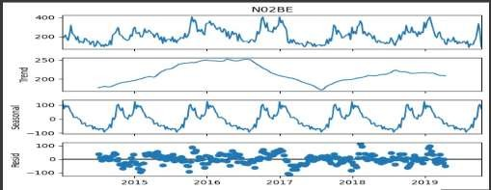
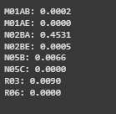
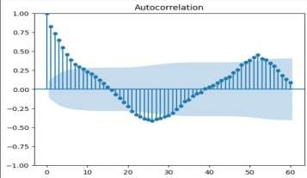
Health revolution Hack 2025
Data Preprocessing Steps
6.ADF test for dataset stationarity
5. Decomposition (Sample drug 2)
7.Made the dataset stationary
8. ACF for a sample drug N02BE
for determining p,d,q value for ARIMA
11

Slide 12
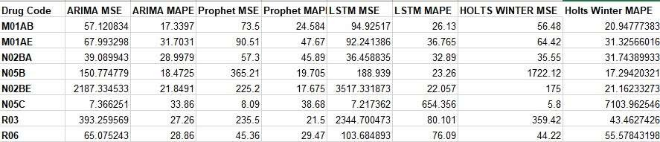
Health revolution Hack 2025
Model Training
Based on both MSE and MAPE values, Prophet performs best for drug codes R03, R06, and N02BE, while ARIMA provides the most accurate results for the remaining five drug codes (M01AB, M01AE, N02BA, N05B, and N05C). When compared with other forecasting models such as LSTM and Holt’s Winter, ARIMA and Prophet consistently delivered better overall performance for the given drug codes.
12

Slide 13
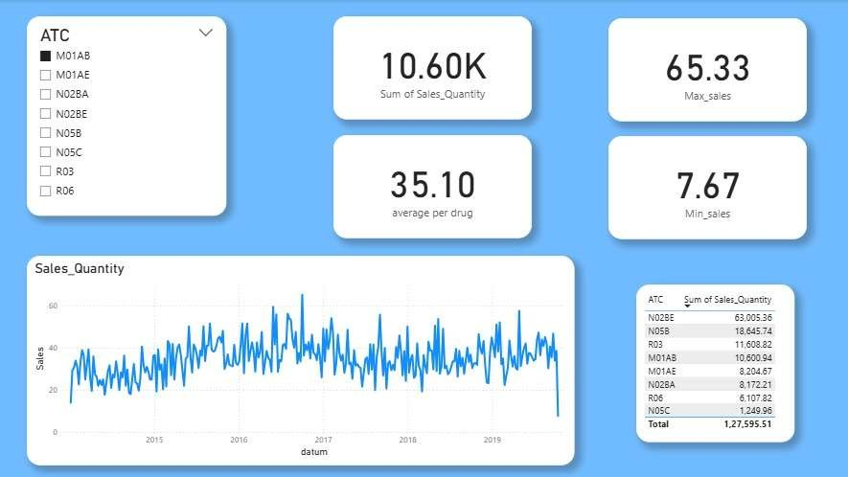
Health revolution
Hack 2025
PowerBI Visualization:

Slide 14
Health revolution Hack 2025
Demo Video Link:
https://drive.google.com/file/d/1jqGgXUzSXcCySW0wOU DM-2yfNni3zuBK/view?usp=sharing
14

Slide 15
Thank you
15

